Slide 1
Python Regular Expressions

Slide 2
Regular Expressions
Regular expressions are a powerful string manipulation tool
All modern languages have similar library packages for regular expressions
A regular expression also referred to as "regex" or "regexp" or "re"
It's provides a concise and flexible means for matching strings of text, such as particular characters, words, or patterns of characters.

Slide 3
Understanding Regular Expressions
Very powerful and quite cryptic
Fun once you understand them
Regular expressions are a language unto themselves
A language of "marker characters" - programming with Characters
It is kind of an "old school" language - compact

Slide 4
Python Regular Expression Quick Guide Python Regular Expression Quick Guide Python Regular Expression Quick Guide Python Regular Expression Quick Guide Python Regular Expression Quick Guide
Regular Expression Quick Guide
^ Matches the beginning of a line
$ Matches the end of the line
. Matches any character
\s Matches whitespace
\S Matches any non-whitespace character
* Repeats a character zero or more times
*? Repeats a character zero or more times (non-greedy)

Slide 5
Continue...
+ Repeats a character one or more times
+? Repeats a character one or more times (non-greedy)
[aeiou] Matches a single character in the listed set
[^XYZ] Matches a single character not in the listed set
[a-z0-9] The set of characters can include a range
( Indicates where string extraction is to start
) Indicates where string extraction is to end

Slide 6
Using Regular Expression Methods
The "re" package provides several methods to perform queries on an input string.
The method we going to see are
1.re.match()
2.re.search()
3.re.findall()

Slide 7
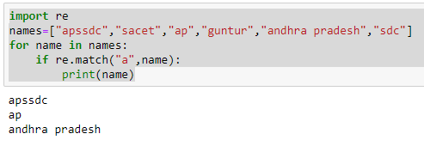
1.re.match()
The match method checks for a match only at the beginning of the string.

Slide 8
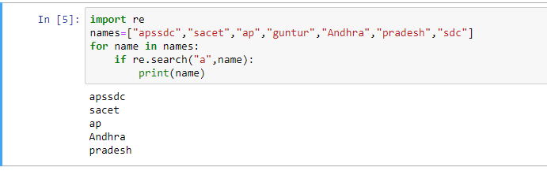
2.re.search()
The search() function takes the "pattern" and "text" to scan from our main string and returns a match object when the pattern is found or else not match if the pattern is not found.

Slide 9
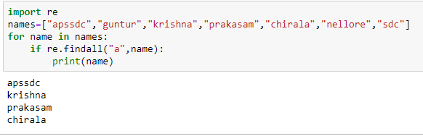
3.re.findall()
Re.findall() module is used when you want to iterate over the lines of the file, it will return a list of all the matches in a single step

Slide 10
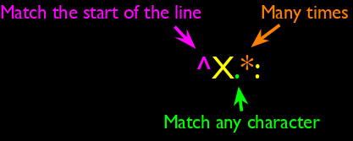
Wild -Card Characters
The dot character matches any character
If you add the asterisk character, the character is "any number of times" X-Sieve: CMU Sieve 2.3 ^X.*: X-DSPAM-Result: Innocent X-DSPAM-Confidence: 0.8475 X-Content-Type-Message-Body: text/plain

Slide 11
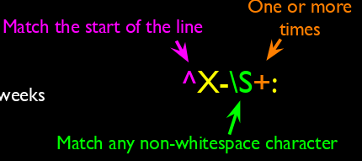
Fine- Tuning Your Match
Depending on how "clean" your data is and the purpose of your application, you may want to narrow your match down a bit
X-Sieve: CMU Sieve 2.3 X-DSPAM-Result: Innocent X-Plane is behind schedule: two weeks

Slide 12
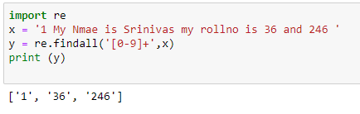
Matching and Extracting Data
The re.search() returns a True/False depending on whether the string matches the regular expression
If we actually want the matching strings to be extracted, we use Re.findall()
[0-9]+ One or more digits

Slide 13
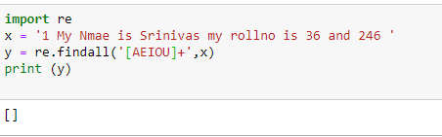
Matching and Extracting Data
When we use re.findall() it returns a list of zero or more sub-strings that match the regular expression

Slide 14
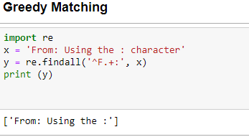
Warning: Greedy Matching
The repeat characters (* and +) push outward in both directions (greedy) to match the largest possible string
^F.+:

Slide 15
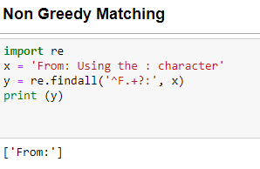
Non- Greedy Matching
Not all regular expression repeat codes are greedy! If you add a ? character - the + and * chill out a bit... ^F.+?:

Slide 16
Using re.search() find the data in file.
When yu want to find a data in a file
import re file = open('filename.txt') for data in file: if re.search('From:', data) : print (data)

Slide 17
Fine Tuning String Extraction
Parenthesis are not part of the match - but they tell where to start and stop what string to extract
From stephen.marquard@uct.ac.za Sat Jan 5 09:14:16 2008 >>> y = re.findall('\S+@\S+',x)
>>>print (y) ['stephen.marquard@uct.ac.za'] >>> y = re.findall('^From (\S+@\S+)',x) >>> print y ['stephen.marquard@uct.ac.za']

Slide 18
Continue....
>>> data = 'From stephen.marquard@uct.ac.za Sat Jan 5 09:14:16 2008' >>> atpos = data.find('@') >>> print (atpos) 21 >>> sppos = data.find(' ',atpos) >>> print (sppos) 31 >>> host = data[atpos+1 : sppos] >>> print (host) uct.ac.za

Slide 19
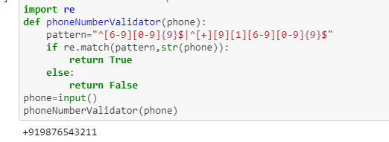
Sample patterns
Write a pattern to validate India Phone number
"^[6-9][0-9]{9}$|^[+][9][1][6-9][0-9]{9}$"

Slide 20
Write a pattern to validate an Email
Specifications
Username
Length of username : [6,15]
No special characters other than _ .
Should not begin and end with _ .
Character Set : all digits and lower case alphabet _.
domain
Length of domain : [3, 18]
No special characters
Character Set : all digits and lower case alphabet

Slide 21
Continue...
extension
Length of extension : [2, 4]
No special characters
Character Set : lower case alphabet
"^[0-9a-z][0-9a-z_.]{4,14}[@][a-z]{2,13}[.][a-z]{1,4}"

Slide 22
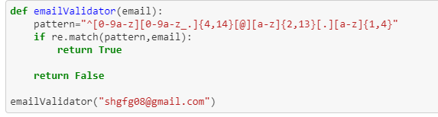
Valid Email ID Pattern

Slide 23
Thank You

